Slide 1
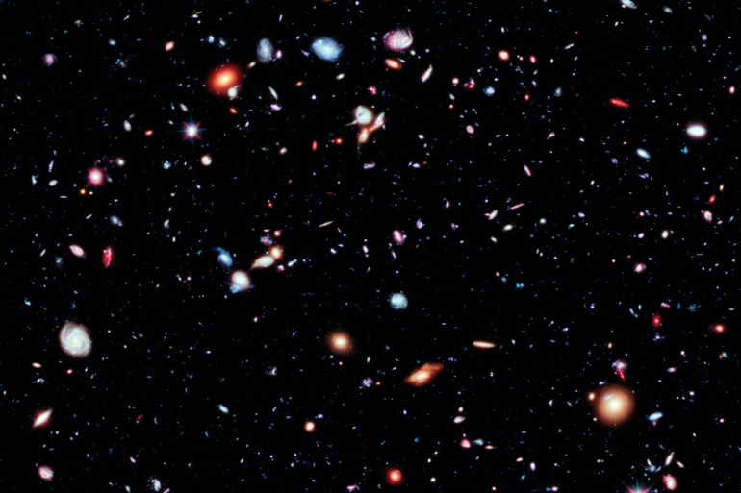
Spring 1 2025
To Infinity and beyond
Knowledge
Key Questions
Literacy & Key texts
We know that we live on the planet Earth and the moon orbits it.
We know that there are 8 planets in the solar system that orbit the sun.
We know that astronauts go to space in rockets
We know that the first man on the moon was Neil Armstrong in 1969.
We know who Tim Peake is and that astronauts live differently in space compared to earth.
We know about some similarities and differences between planets and we can tell you facts about chosen planet.
We know what the environment on Earth is different to the Moon.
Describe the features of the Solar System.
What is the same/different between each planet?
What is the same/different between the environments?
What facts can you tell me about your planet?
What do you think happens in Space?
What happens when people go to Space?
Can you tell me about an astronaut?
What do you know about the moon landings?
Celebrating New Year.
Non-fiction books about the Solar System.
‘The Queen’s Lift Off’ by Steve Anthony.
‘Whatever Next’ by Jill Murphy.
‘Aliens Love Underpants’ by Claire Freedman.
‘Look up’ by Nathan Bryon and Dapo Adeola.
Maths – White Rose
PD/EAD/UW
RE
Comparing numbers to 5/one less
Composition of 5 – number bonds
Weight & Capacity
Number 6 & making pairs
Number 7
Number 8
Gymnastics all term.
Compare and contrast characters from stories including figures from the past.
Recognise some environments as different from where they live.
Return to and build on previous learning refining ideas and developing the ability to represent them.
Explore and engage in music making and dance performing solo or in groups.
How do Islam and other faiths use water and why?

